Slide 1






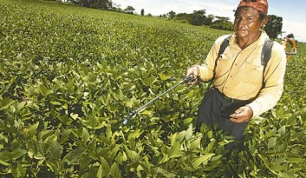
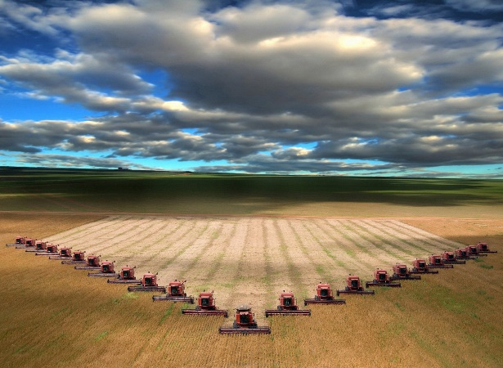
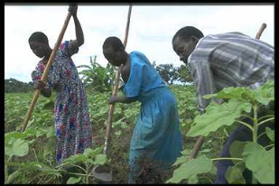
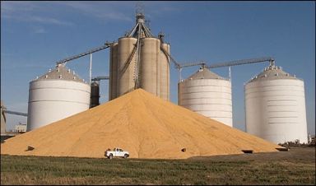
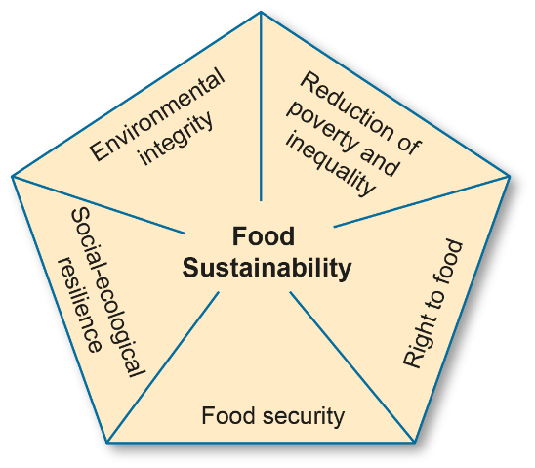
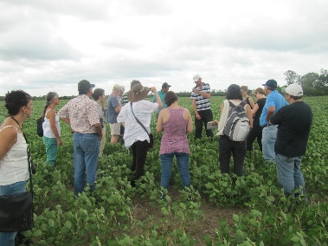
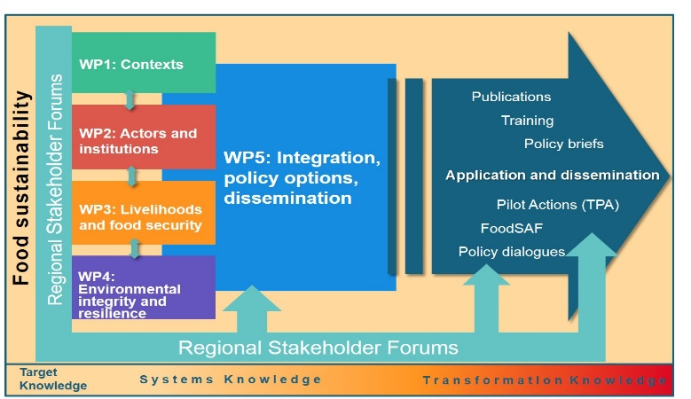




Towards Food Sustainability: Reshaping the coexistence of different food systems in South America and Africa
Objectives
Operationalize the five pillar concept of food sustainability for the sustainability assessment of co-existing food systems.
Provide knowledge on innovations for improving the sustainability of individual and co-existing food systems.
Identify policy options for more sustainable food systems.
Development relevance
Create awareness on trade-offs between different policies for food security in view of food sustainability.
Promotion of innovations and policy options
Project organisation
Interdisciplinary team representing: Human & physical geography, human rights, international law, trade economics, social anthropology, agroecology
Researchers:
9 PhD students (3 in Switzerland, 3 in Kenya, 3 in Bolivia)
5 Master’s in Kenya, 5 in Bolivia
4 Postdocs in Switzerland, 2 in Kenya, 2 in Bolivia, stakeholder forums
Scientific contributions
Putting food security in a sustaina- bility context that links it to:
Human right to food
Poverty and inequality
Environmental integrity
Social-ecological resilience
Develop and test a Food Sustaina-
bility Assessment Framework (FoodSAF)
Preparation workshop in Bolivia, visiting soy farmers, Feb. 2015
Work Packages
and
Transdis-ciplinary approach
Study areas
«Soy cluster» Santa Cruz Department, Bolivia,
Laikipia/Mount Kenya Region, Kenya, ranching and horticulture.

