Slide 1

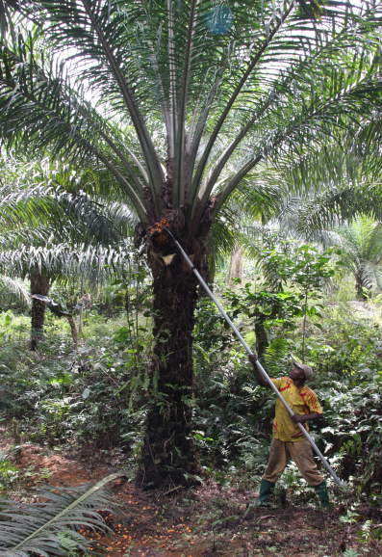
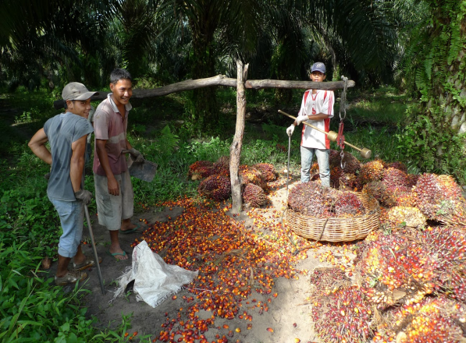
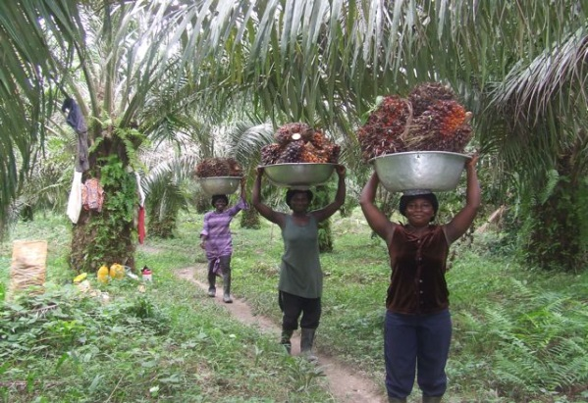
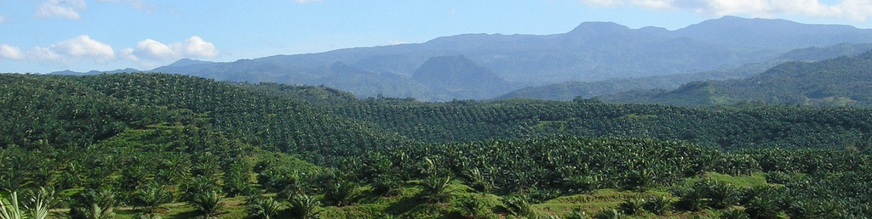


Oil Palm Adaptive Landscapes
Oil palm cultivation is a principal driver of tropical land-use change and deforestation. Oil palm provides significant earnings for countries, corporations and smallholders, but often at great environmental and social costs within and beyond the landscapes where it is grown.
Project Goal
OPAL will explore alternative oil palm trajectories with stakeholders and decision makers in Indonesia, Cameroon, and Colombia to help chart a path towards more sustainable and inclusive futures.
Research framework
Future scenarios, underpinned by socioeconomic and ecological research, will be refined and validated using interactive models in the form of role playing games (RPGs). Engaging stakeholders with RPGs will provide a basis for shared understanding across stakeholder interest.
Development relevance
Despite being fraught with pervasive uncertainties, the sector is evolving to take account of environmental and social goals.
Improved understanding of decision-making processes will help the sector to chart a path towards more sustainable and inclusive futures.
Project team
The consortium, led by ETH Zurich, includes international institutions (CIFOR, CIRAD, WWF), universities (University of Javeriana, Bogor Agricultural University, EPF Lausanne), and NGOs (NES Naturaleza), and a number of local grower associations.

